Slide 1
Ordering decimals
Comparing and ordering fractions and decimals (positive and negative)

Slide 2
how to use Oak lessons

Slide 3
I can compare decimals using < and >.

Slide 4
The value of a digit in a number based on where it is placed is known as place value.
A number is in decimal form when the decimal point is shown and there are digits to the right of the decimal point.

Slide 5

Ordering decimals
Comparing decimals using a place value chart
Putting decimals on a number line
Ordering decimals

Slide 6











Comparing decimals using a place value chart
Place value charts are a really useful tool when comparing decimals.
HMn | TMn | Mn | HTh | TTh | Th | H | T | O | T | H | Th | TTh
th
th
th
th
Here is a reminder of what our place value chart looks like.

Slide 7
Comparing decimals using a place value chart
Is it always necessary to use a place value chart?
No, you should always look at what you are comparing as some comparisons may be obvious.
HMn | TMn | Mn | HTh | TTh | Th | H | T | O | T | H | Th | TTh
th
th
th
th
E.g. Which is greater?
3.4792 or 4.4791
Here you might be tempted to use the grid as the decimal parts are very similar.
However, the second number is greater as it has a 4 in the ones column and the first one only has a 3 in the ones column.

Slide 8
Comparing decimals using a place value chart
Compare these two numbers.
Which is greater?
4.125649
.
4
1
2
5
6
4
9
.
4
1
2
5
4
5
4.125459
9
4.125649 > 4.125459
or
4.125459 < 4.125649

Slide 9
Comparing decimals using a place value chart
Compare these two numbers.
Which is greater?
0.0006458
.
0
0
0
0
6
4
5
8
.
0
0
0
0
6
4
3
0.0006439
9
0.0006458 > 0.0006439
or
0.0006439 < 0.0006458

Slide 10
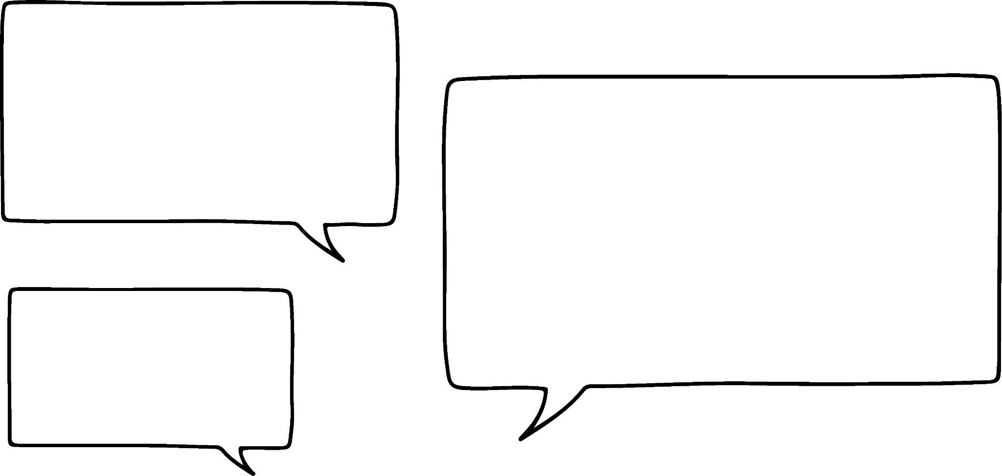


Comparing decimals using a place value chart
Aisha and Jacob are playing a game.
Aisha scores 1542.12 and Jacob scores 1542.2
I’ve won. My score is the highest as it is longer.
No my score is higher.
Aisha
Jacob
Jacob is correct.
Write a sentence to convince someone that Jacob is correct.
E.g. Up to the tenths column their scores have the same value but Jacob has a larger digit in the tenths column.

Slide 11
Comparing decimals using a place value chart
Sort these decimals into the correct groups.
0.
2
5
2
3
0.
2
5
7
2
Less than 0.2572
Larger than 0.2572
0.2523

Slide 12
Comparing decimals using a place value chart
Sort these decimals into the correct groups.
0.
2
6
4
8
0.
2
5
7
2
Less than 0.2572
Larger than 0.2572
0.2523
0.2648

Slide 13
Comparing decimals using a place value chart
Sort these decimals into the correct groups.
0.
2
4
6
0.2572
Less than 0.2572
Larger than 0.2572
0.2523
0.2648
0.246

Slide 14
Comparing decimals using a place value chart
Sort these decimals into the correct groups.
0.
2
5
0
2
4
0.
2
5
7
2
Less than 0.2572
Larger than 0.2572
0.2523
0.2648
0.246
0.25024

Slide 15
Comparing decimals using a place value chart
Sort these decimals into the correct groups.
0.
2
9
1
0.
2
5
7
2
Less than 0.2572
Larger than 0.2572
0.2523
0.2648
0.246
0.291
0.25024

Slide 16
Comparing decimals using a place value chart
Complete the boxes with examples and non-examples of numbers greater than 25.781
Using the digits
1
2
5
7
8
examples
non-examples
E.g.
57.128
25.817
25.871
125.78
E.g.
21.578
25.178
25.187
1.2578

Slide 17
Comparing decimals using a place value chart
Work out which of the following are true.
Rearrange the letters of the true statements to make a word.
L | M | N | D
B | I | T | Q
S | P | I | Y
E | R | O | A
G | U | V | C
5.68 > 5.8
0.561 > 0.651
5.68 < 5.8
0.84 > 0.804
1.45 < 1.408
0.567 < 0.576
12.31 > 12.231
1.427 < 1.472
1.6 < 1.514
12.48 > 12.84
13.2 > 13.123
3.68 > 3.658
0.972 > 0.927
0.031 < 0.013
11.01 > 11.101
0.071 > 0.0072
0.36 < 0.237
2.2611 < 2.611
3.68 < 3.256
0.0205 > 0.052

Slide 18
Comparing decimals using a place value chart
Work out which of the following are true.
Rearrange the letters of the true statements to make a word.
L | M | N | D
B | I | T | Q
S | P | I | Y
E | R | O | A
G | U | V | C
5.68 > 5.8
0.561 > 0.651
5.68 < 5.8
0.84 > 0.804
1.45 < 1.408
0.567 < 0.576
12.31 > 12.231
1.427 < 1.472
1.6 < 1.514
12.48 > 12.84
13.2 > 13.123
3.68 > 3.658
0.972 > 0.927
0.031 < 0.013
11.01 > 11.101
0.071 > 0.0072
0.36 < 0.237
2.2611 < 2.611
3.68 < 3.256
0.0205 > 0.052
The letters rearrange to make the word inequality.

Slide 19
Ordering decimals
Comparing decimals using a place value chart
Putting decimals on a number line
Ordering decimals

Slide 20
Putting decimals on a number line
0
1
Write down a number between the two numbers on the number line.
E.g. 0.18, 0.42, 0.805, …

Slide 21
Putting decimals on a number line
0
0.5
Write down a number between the two numbers on the number line.
E.g. 0.2, 0.05, 0.49…

Slide 22
Putting decimals on a number line
0
0.1
Write down a number between the two numbers on the number line.
E.g. 0.09, 0.003, 0.0145…

Slide 23
Putting decimals on a number line
0
0.05
Write down a number between the two numbers on the number line.
E.g. 0.04, 0.025, 0.00478 …

Slide 24
Putting decimals on a number line
What number is the arrow pointing to?
0
1
One is split into ten equal parts so each interval is one tenth, that is 0.1
How can it be pointing to 4? It is between 0 and 1.
Of course, I just counted the number of lines.
It is pointing at 4.
So it is 0.4
Aisha
Jacob

Slide 25
Putting decimals on a number line
Is the arrow still pointing at 0.4?
0
1
This time each unit is split into 5 parts.
1 ÷ 5 = 0.2
Now the arrow is pointing at 0.8.

Slide 26
Putting decimals on a number line
Put these numbers on the number line.
0.8
1.3
0.25
1.65
0.25
0.8
1.3
1.65
0.2
0.3
1.6
1.7
0
1
Firstly we need to to work out what each interval is worth.
1 unit is split into 10 parts.
1 ÷ 10 = 0.1, each part is 0.1

Slide 27
Putting decimals on a number line
Put these numbers on the number line.
4.8
5.4
3.7
5.9
3.7
4.8
5.4
5.9
3.6
3.8
5.8
6.0
3
4
5
Again, we need to to work out what each interval is worth.
1 unit is split into 5 parts.
1 ÷ 5 = 0.2, each part is 0.2

Slide 28
Putting decimals on a number line
Match each of the following number lines with the correct interval.
1)
2)
3)
4)
5)
6)
0
1
0.3
0.25
0.1
0.5
0.4
0.2
3
4
2
1
6
5
0
1
0
0.6
8
9
2
3
6
8

Slide 29
Putting decimals on a number line
What number are the arrows pointing to?
a
5.6
b
7.3
6
7
c
2.7
d
3.25
2
3

Slide 30
Putting decimals on a number line
What number is each arrow pointing to?
a)
b)
c)
d)
e)
0
1
3
4
15
16
0
0.1
0.1
0.2

Slide 31
Putting decimals on a number line
What number is each arrow pointing to?
a)
b)
c)
d)
e)
0.7
0
1
4.8
3
4
17.25
15
16
0.025
0
0.24
0.1
0.1
0.2

Slide 32
Ordering decimals
Comparing decimals using a place value chart
Putting decimals on a number line
Ordering decimals

Slide 33
Ordering decimals
If we can compare the size of decimals we can order them from smallest to largest.
Write these numbers in ascending order.
0.88
0.878
0.87
0.078
0.808
.
0
8
8
.
0
8
7
8
.
0
0
8
7
.
0
7
0
8
.
0
8
0
8
0.078
0.808
0.87
0.878
0.88

Slide 34

Ordering decimals
Write these numbers in ascending order.
15.8
0.58
5.08
8.555
0.058
I always use a place value chart to order when there are decimals.
Would you use a place value chart to order these numbers?
Sam
Since they are all fairly different there is probably no need to.

Slide 35

Ordering decimals
Write these numbers in ascending order.
15.8
0.58
5.08
8.555
0.058
0.58, 15.8, 5.08, 0.058, 8.555
0.058, 0.58, 5.08, 8.555, 15.8
0.58, 0.058, 15.8, 5.08, 8.555

Slide 36
Ordering decimals
Write the following numbers in ascending order.
Write the following numbers in ascending order.
1.23
0.32
1.023
0.0132
0.230
0.556
5.065
5.06
0.6
0.065
0.0132
0.065
0.230
0.556
0.32
0.6
1.023
5.06
1.23
5.065

Slide 37
Ordering decimals
Write the following numbers in ascending order.
0.3 0.8 0.2 0.6 0.4
0.12 0.5 0.28 0.31 0.1
0.63 6.03 6.3 0.36 0.063 0.6003
5.75 0.75 0.557 0.505 0.07505
2.341 2.41 1.234 123.4 1.3 1.24

Slide 38
Ordering decimals
Write the following numbers in ascending order.
0.2 0.3 0.4 0.6 0.8
0.1 0.12 0.28 0.31 0.5
0.063 0.36 0.6003 0.63 6.03 6.3
0.07505 0.505 0.557 0.75 5.75
1.234 1.24 1.3 2.341 2.41 123.4

Slide 39
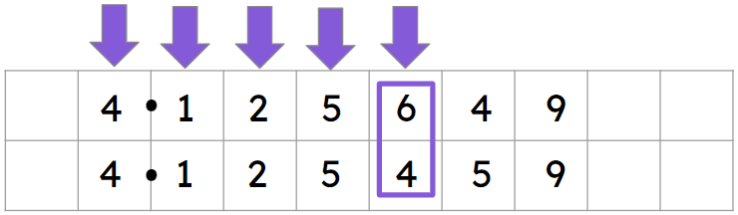
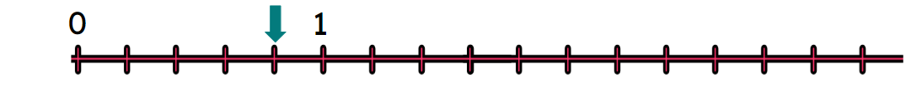
Ordering decimals
When comparing decimals a place value chart can help.
When comparing decimals compare digits starting from the left.
E.g.
When considering the position of a decimal on a number line you must firstly work out the scale being used.
E.g.
This time each unit is split into 5 parts
1 ÷ 5 = 0.2
Now the arrow is pointing at 0.8

Slide 40

© Oak National Academy 2023.
Produced in partnership with Mathematics in Education and Industry.
Licensed on the Open Government Licence v3.0, except where otherwise stated. See Oak terms and conditions.

